Slide 1
Financial Independence
Group 3:
Sonal Dashora, Laura Gibson, Yueying Wang,
Beakal Abera, & Nicole Stucke

Slide 2
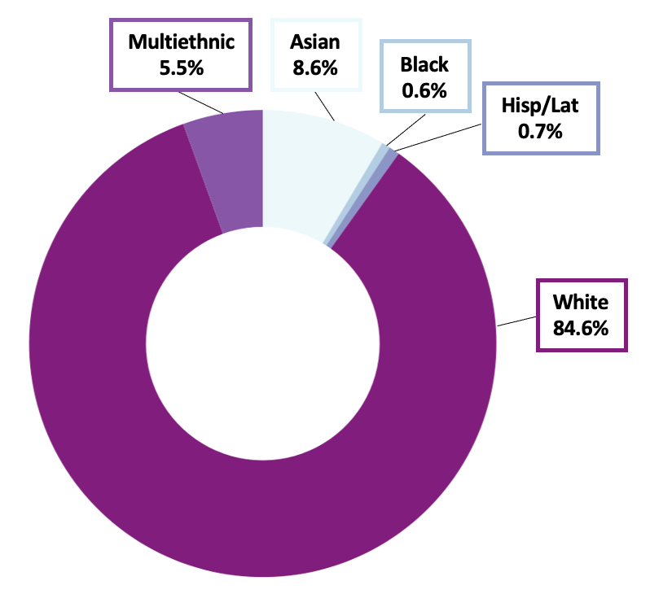
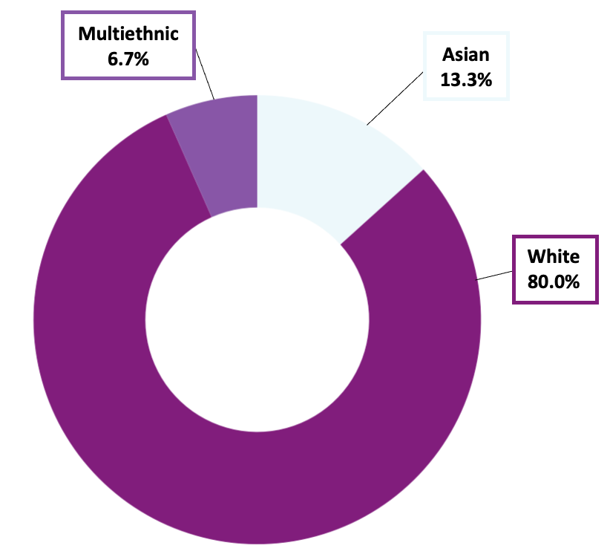
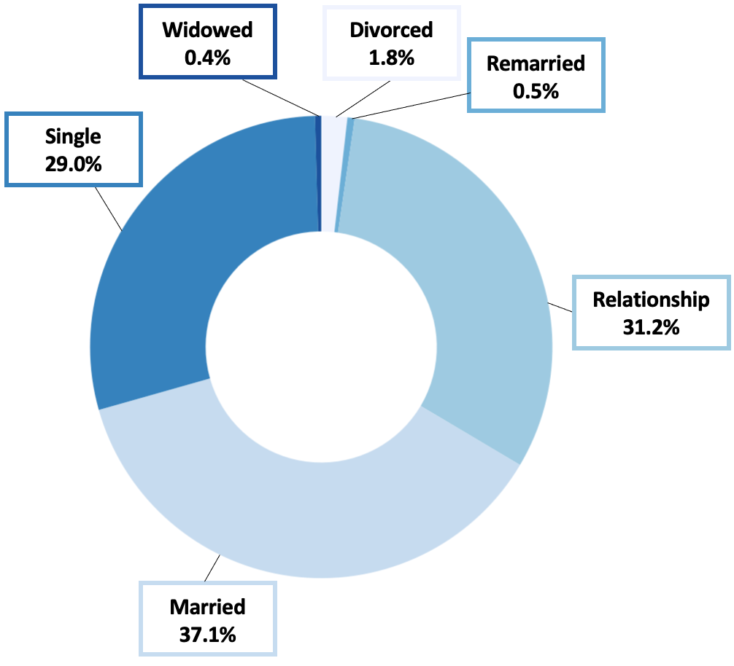
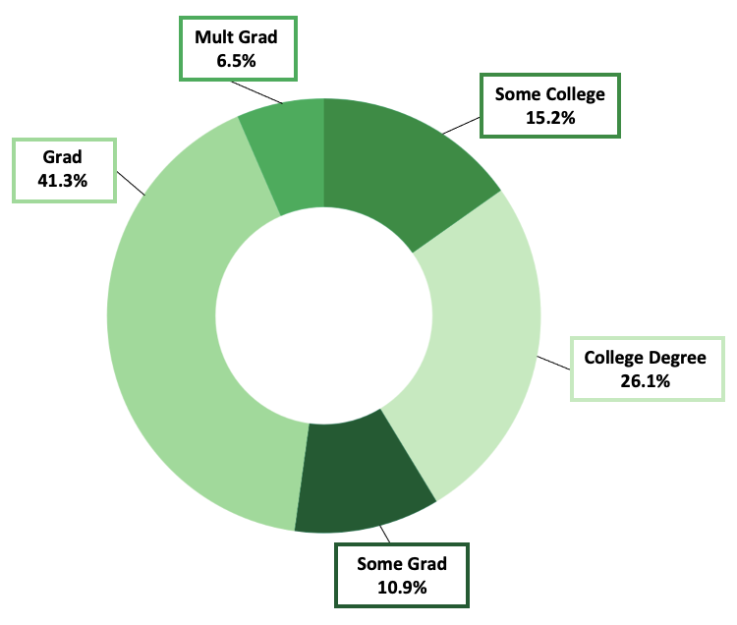
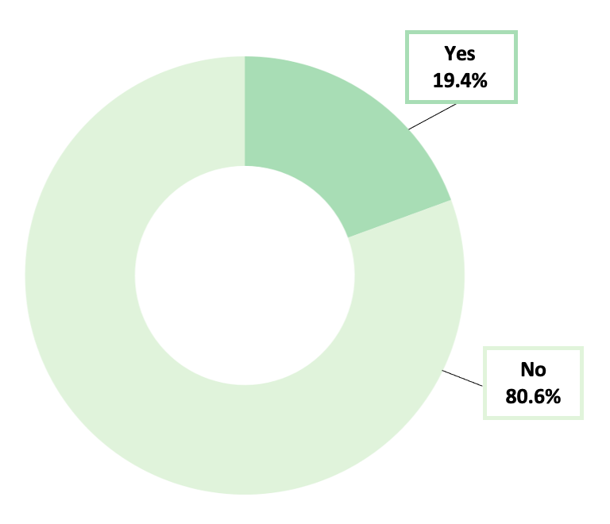
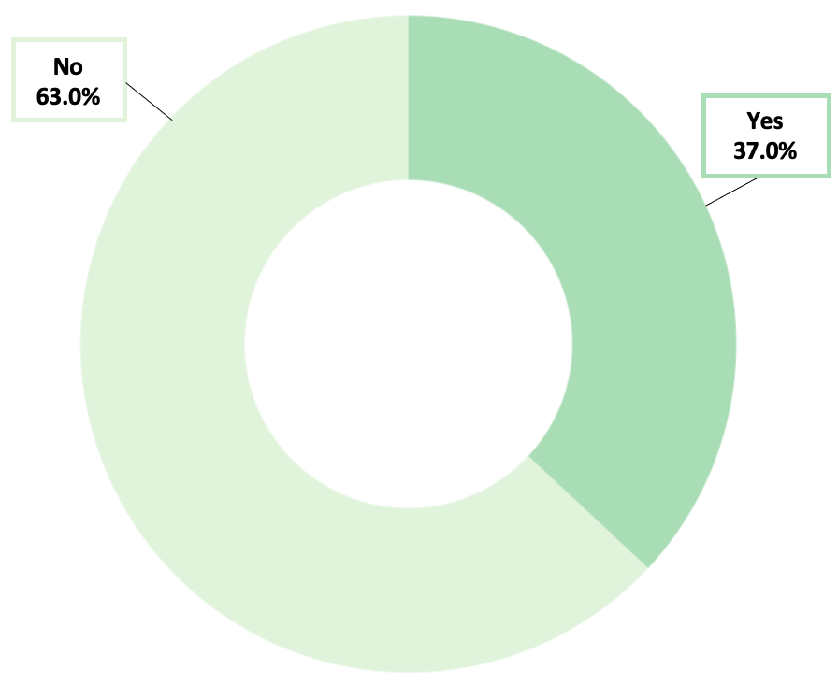
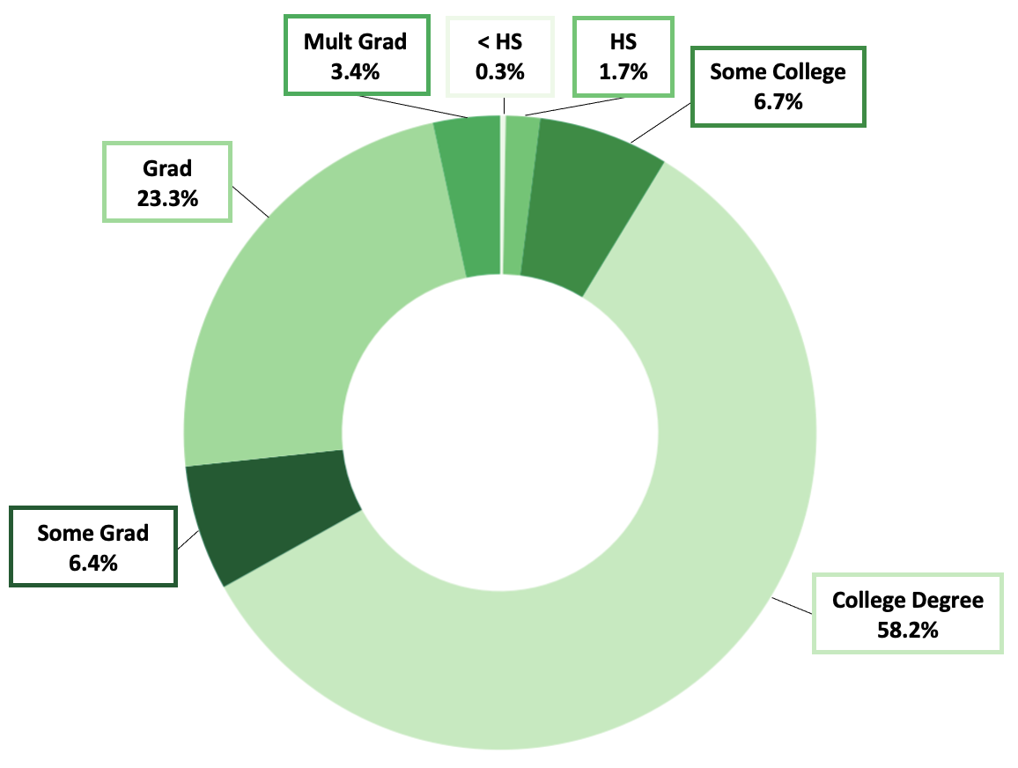
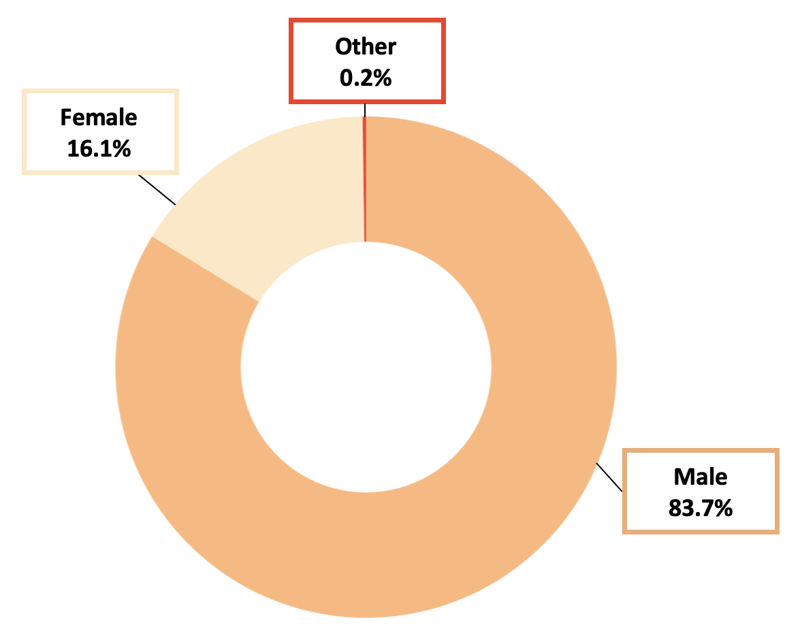
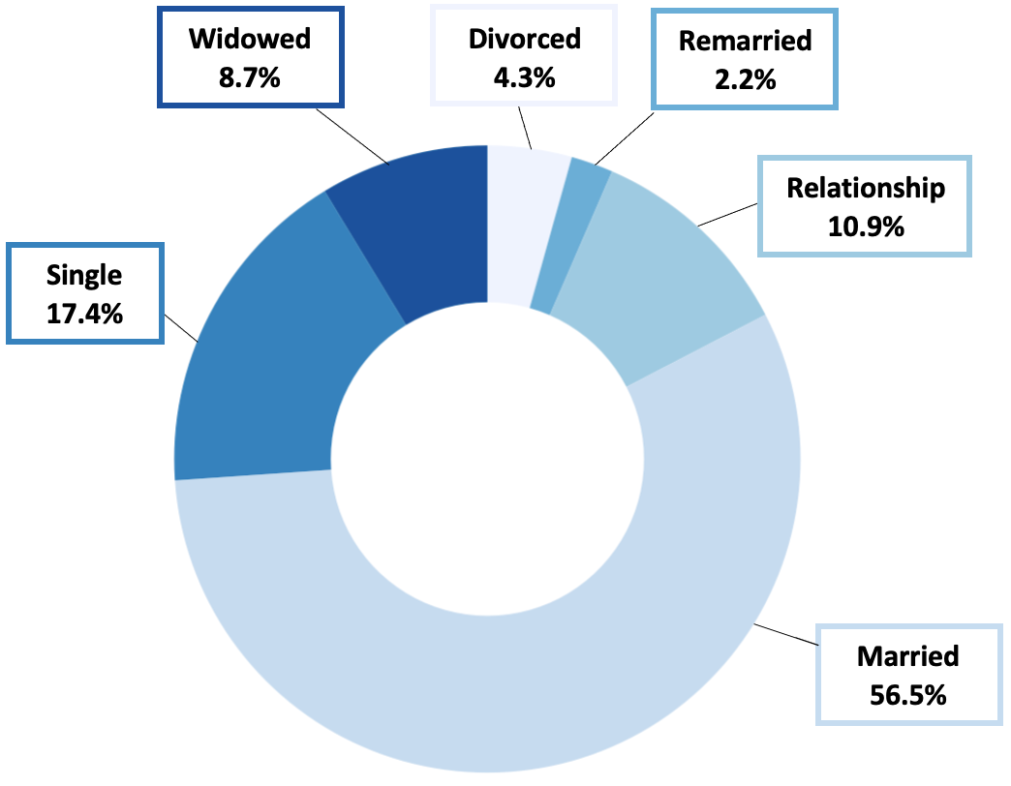
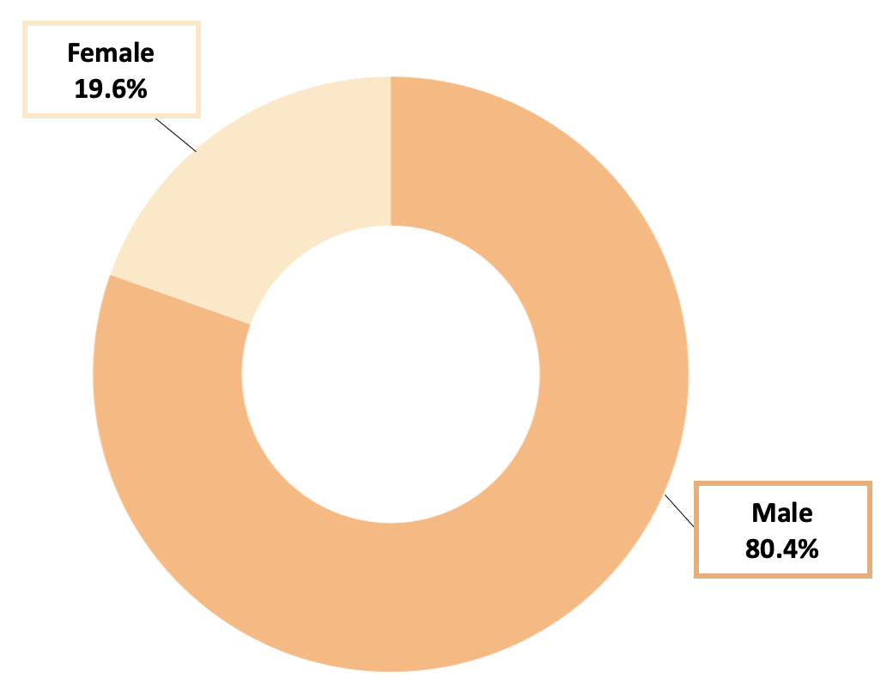
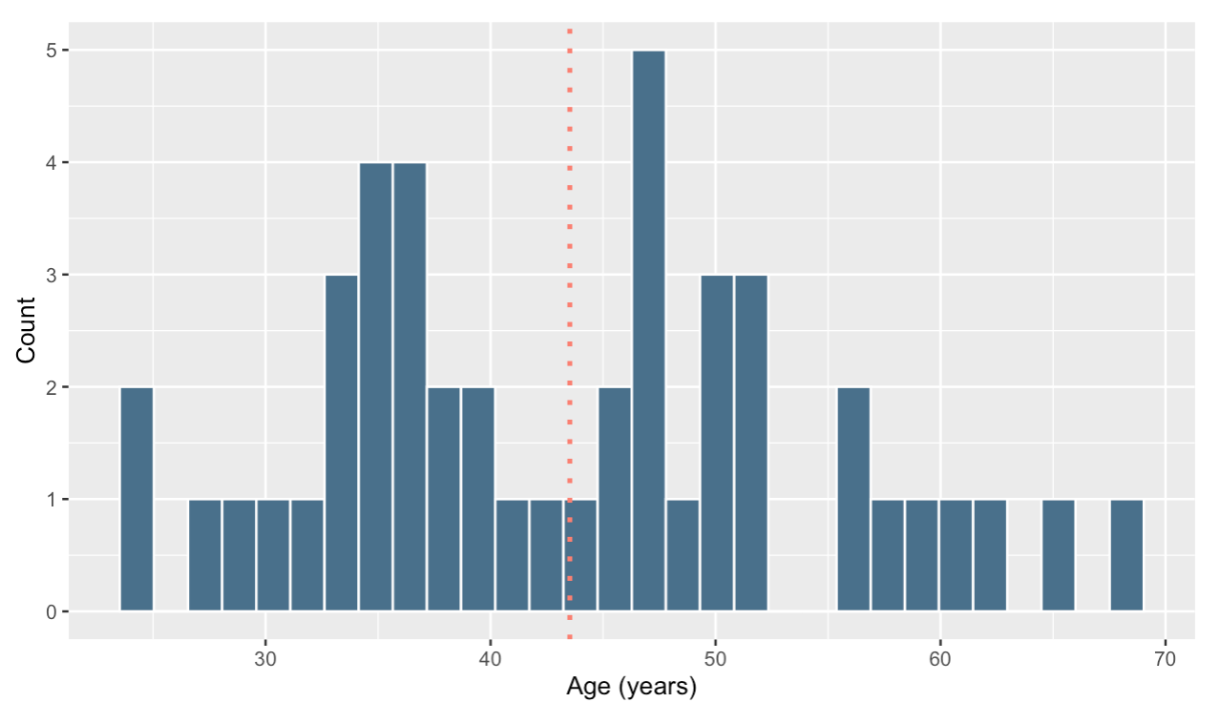
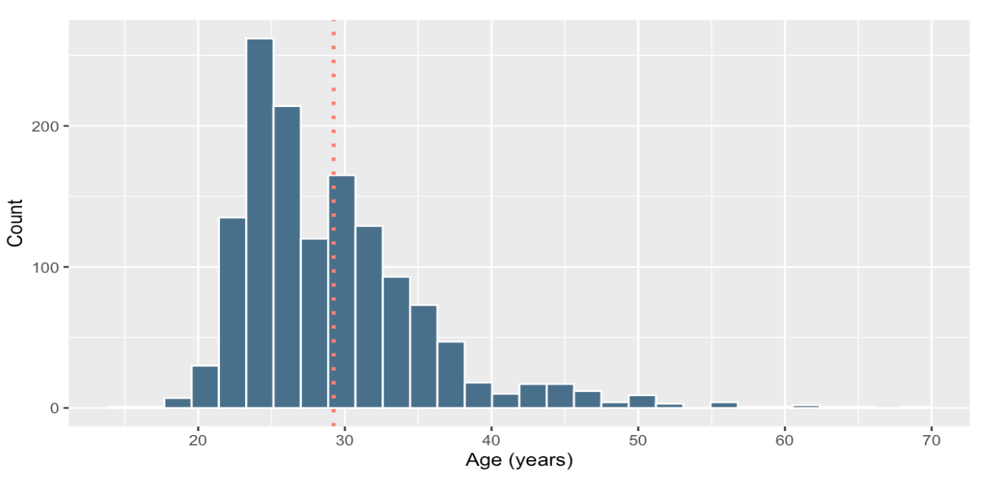
Full Sample (n = 1,378) Only FI (n = 46)
Age
Gender
Relationship Status
Highest Education
Parental Status
Race/Ethnicity
Notes:
N = 1,378
Age - mean just under 30
Gender - mostly male, some female small % other
Ethnicity - mostly white, followed by asian and multiethnic, small % Black or Hispanic/Latinx
Highest ed - most have college, grad degree or multiple grad degrees, followed by some college/some grad, small percent HS or lower
Relationship - pretty well split between in relationship (but not married), married, and single
Kids - majority do not

Slide 3
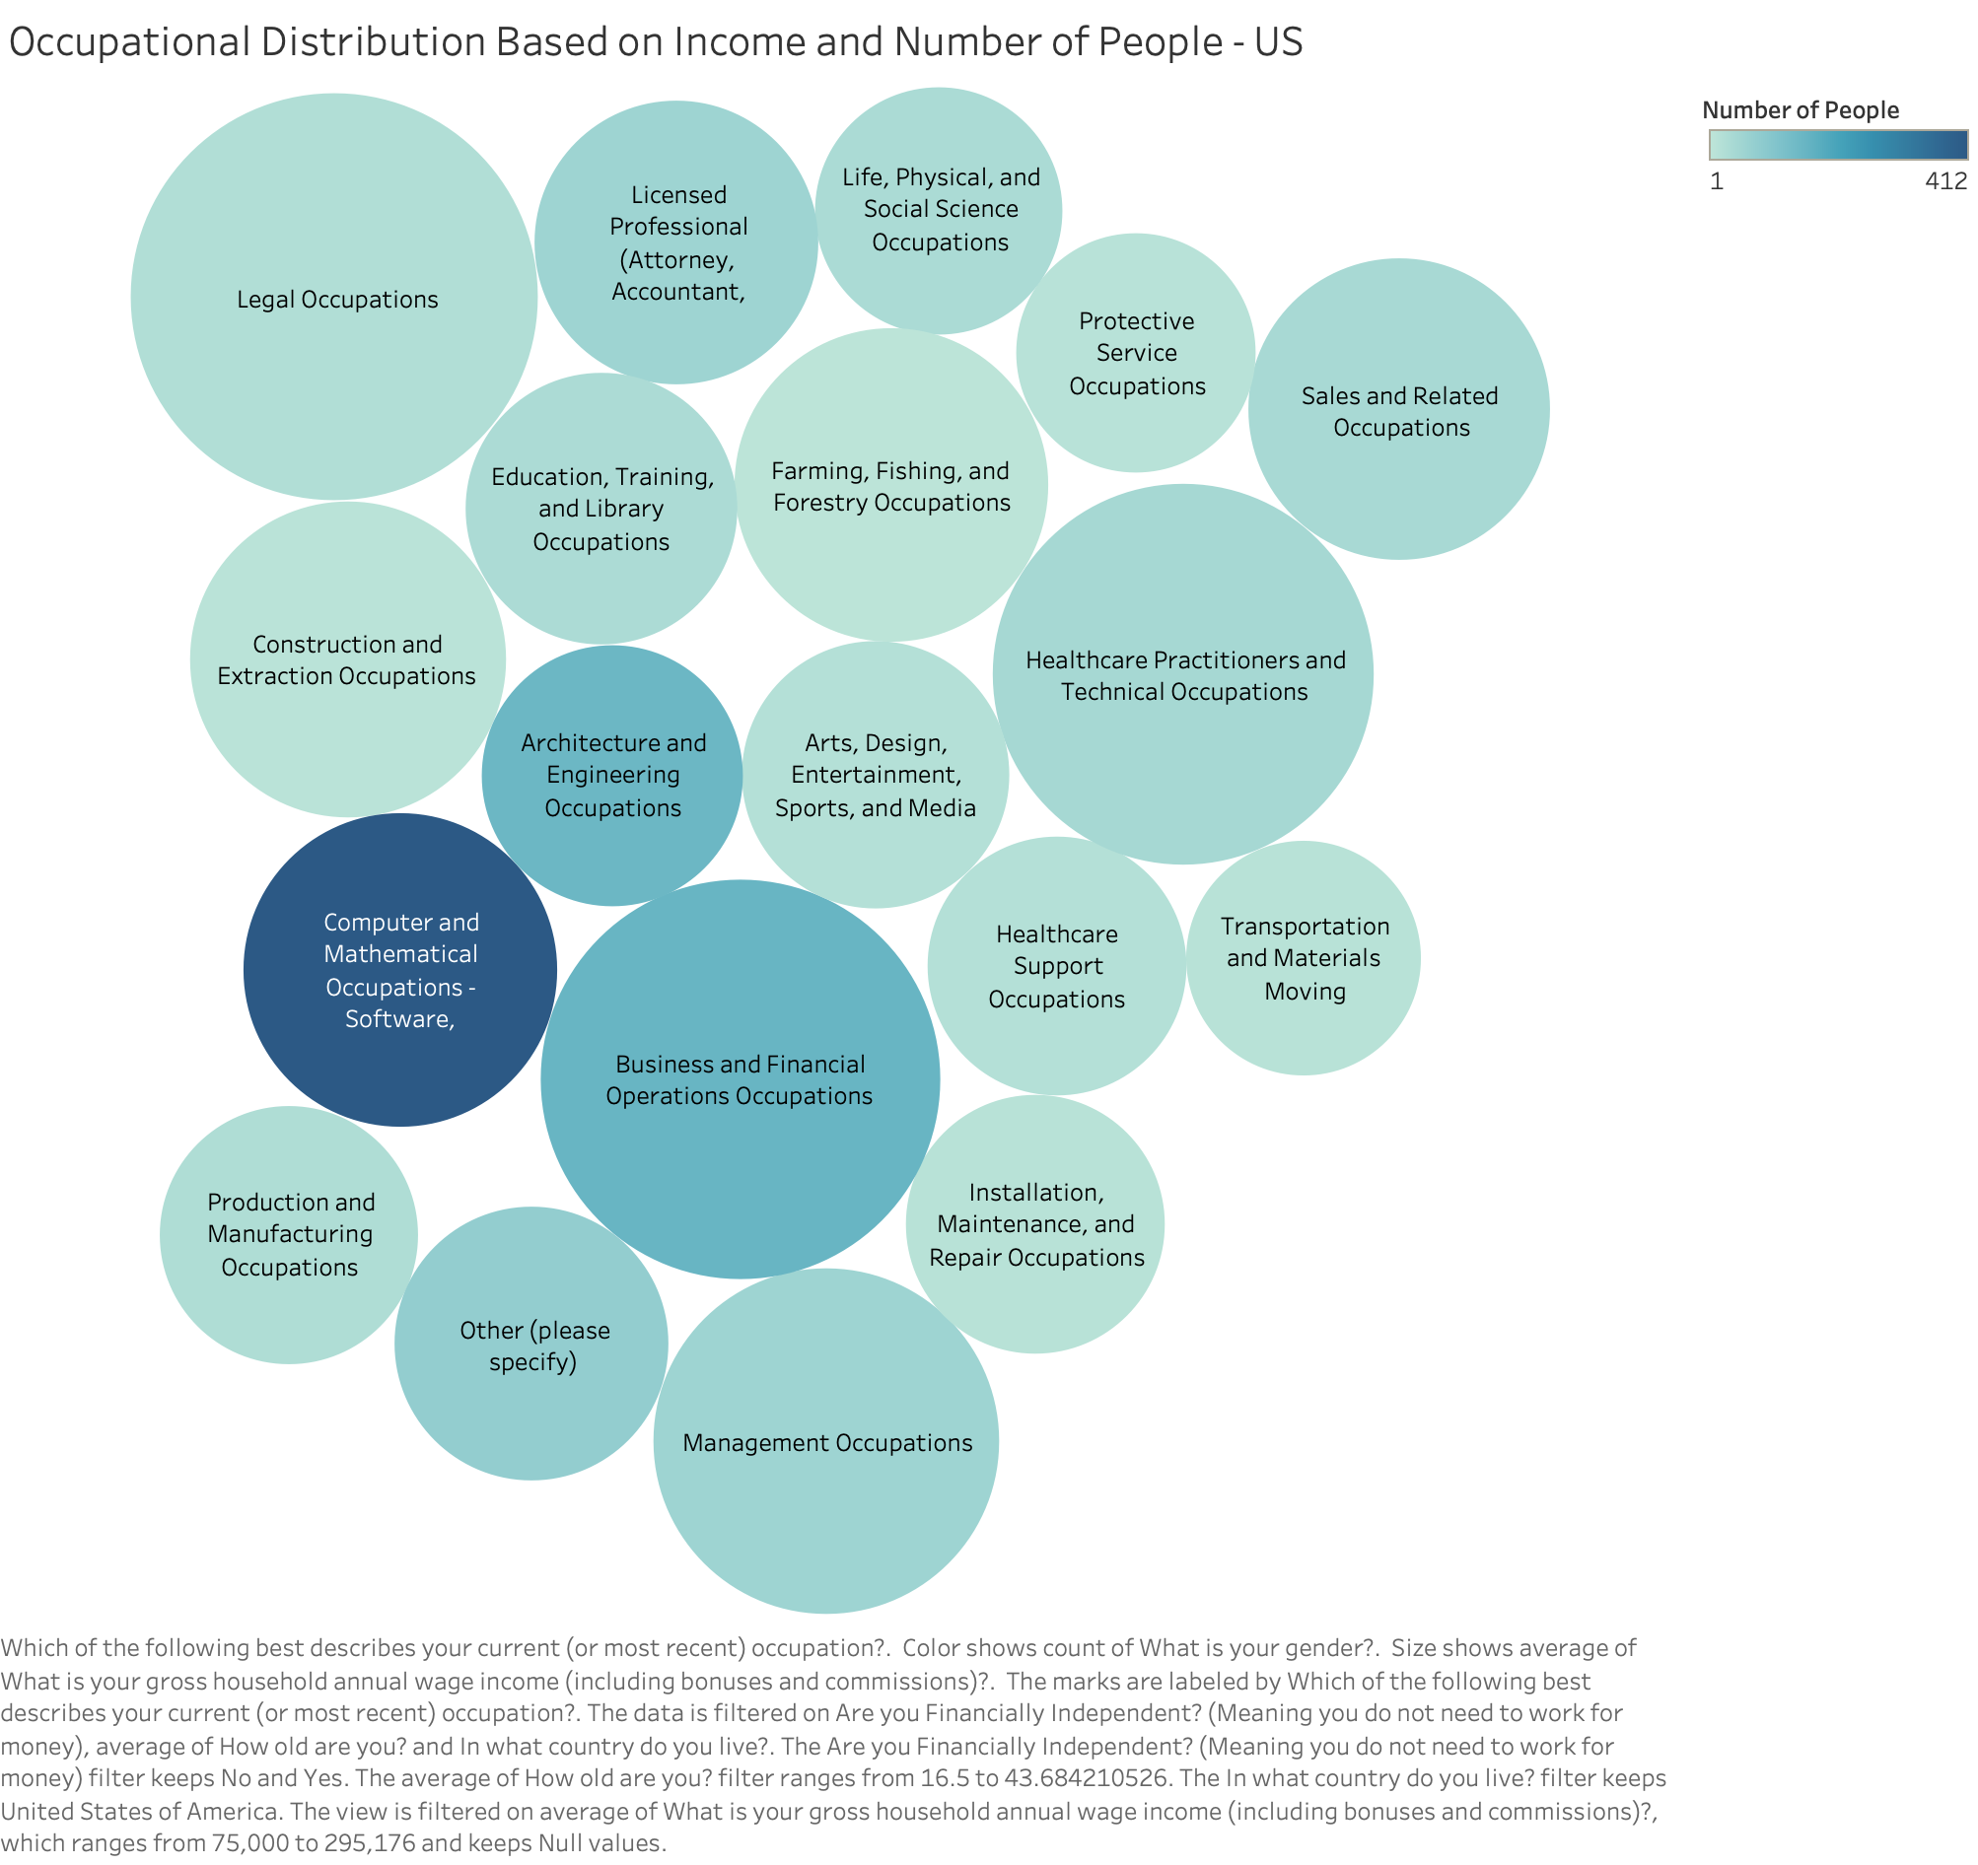
Occupational Distribution Based on Income and Number of People
Size is demonstrative of amount of income made per profession
Legal Occupations have fewer people in the industry but make a significant amount of income

Slide 4
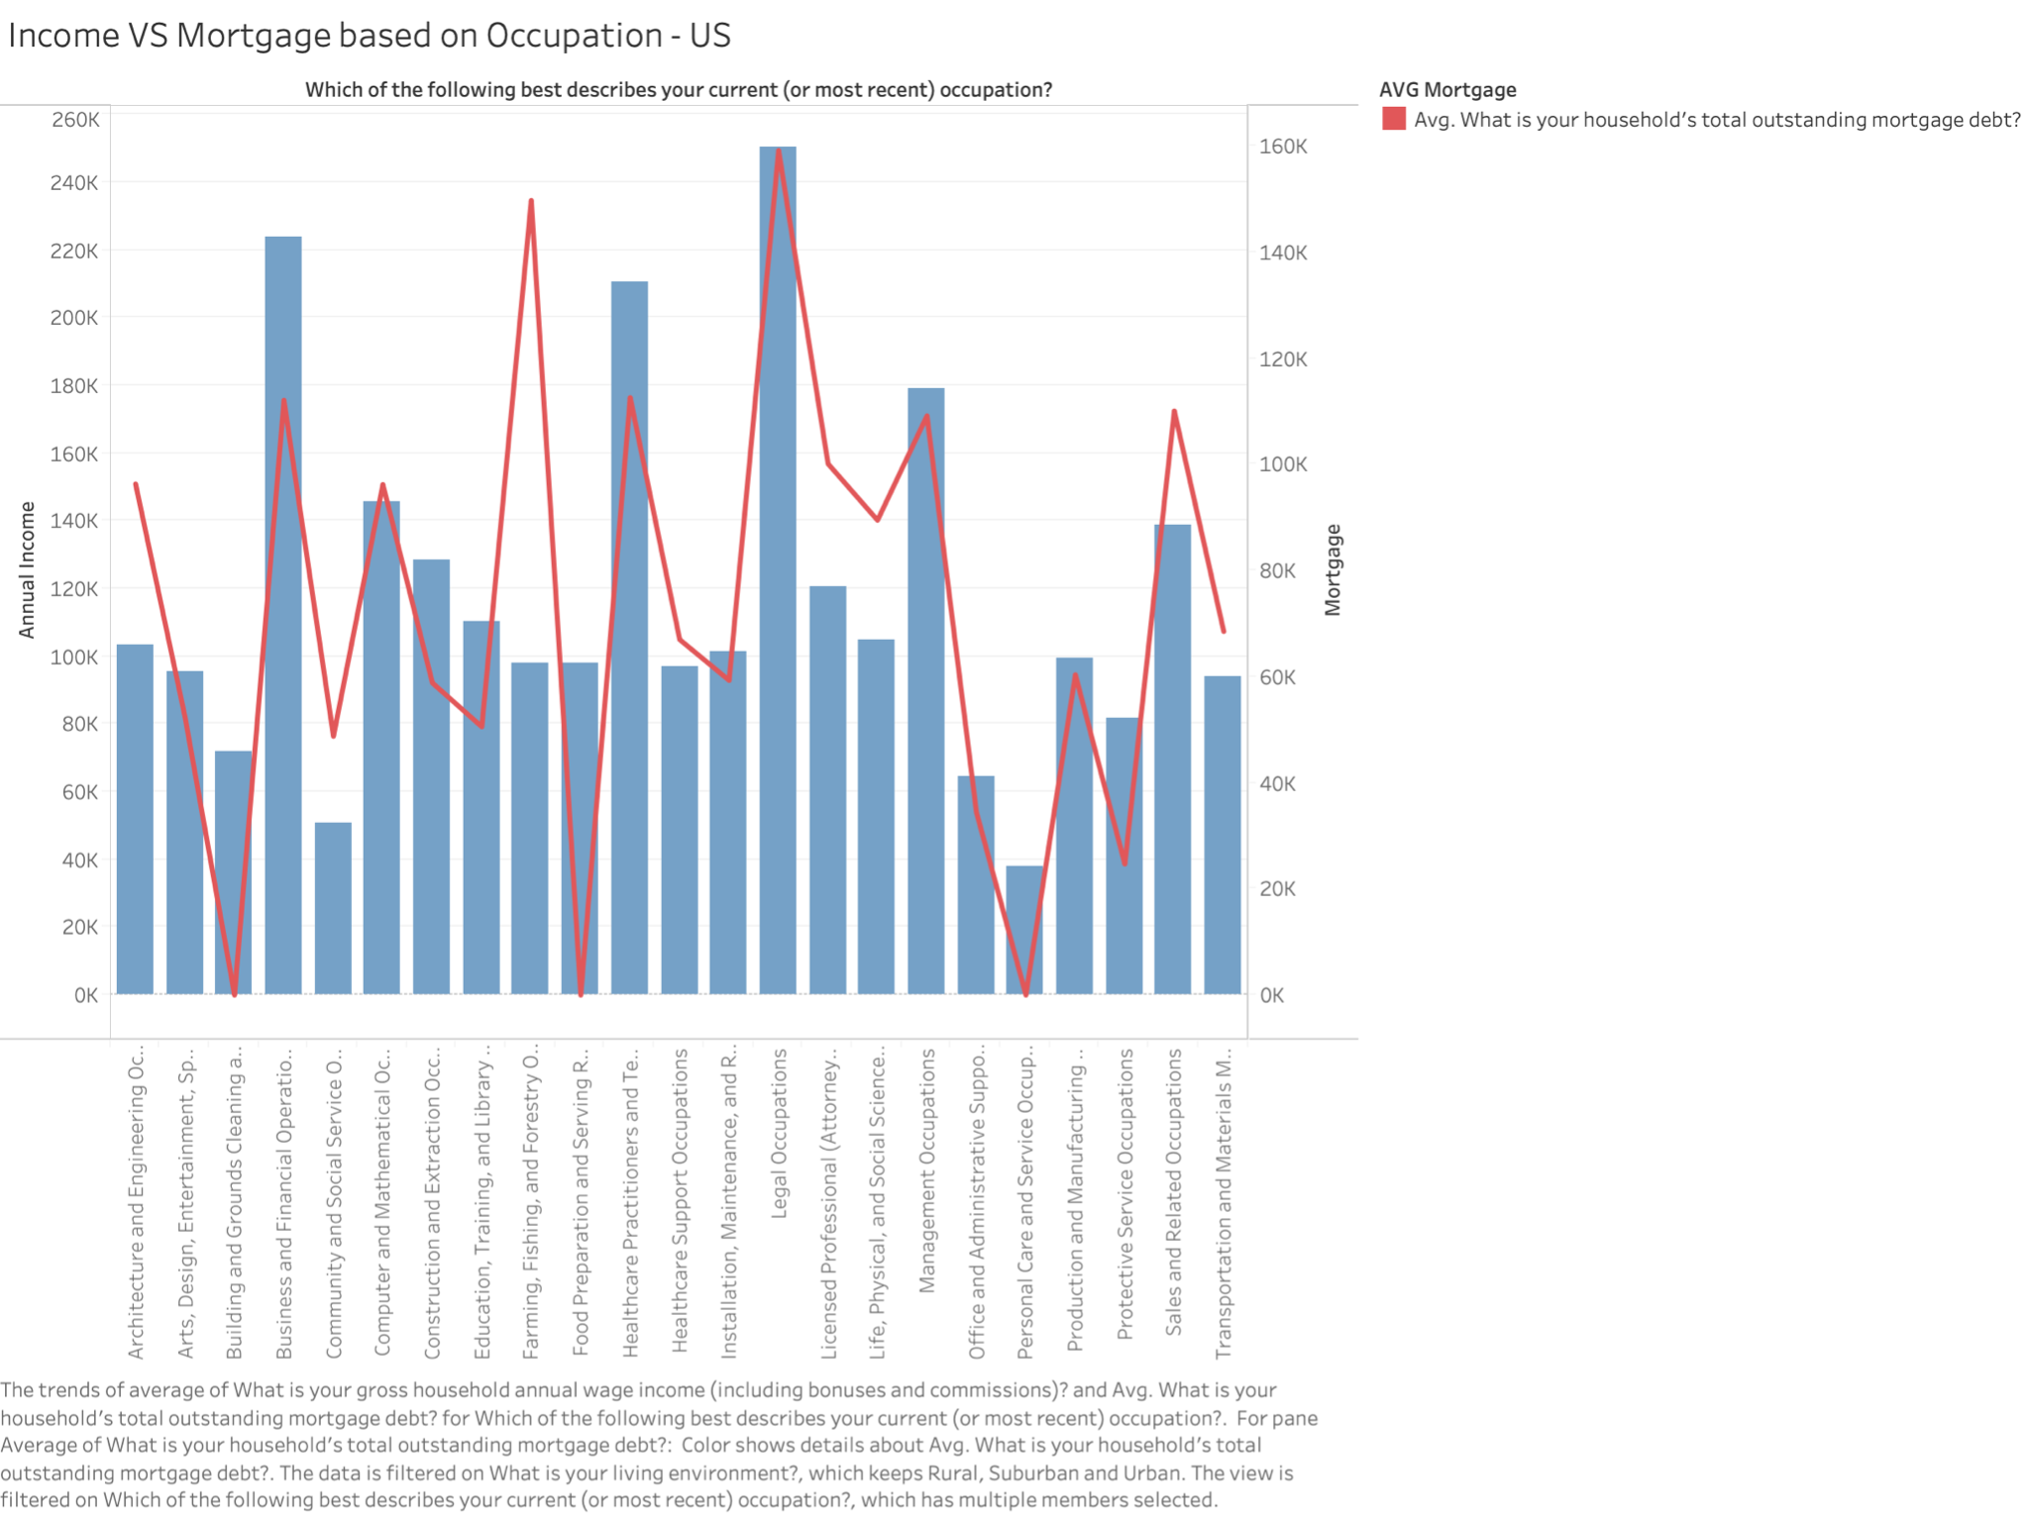
Income vs Mortgage based on Occupation
This graph displays the correlation between income and mortgage
The greatest differential is that of Farming

Slide 5
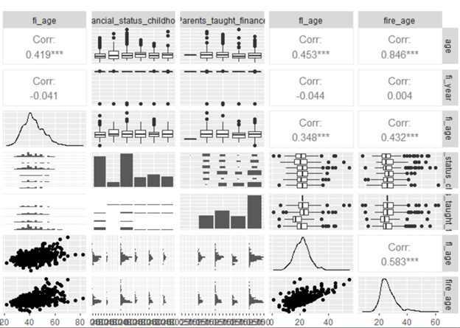
Plotting Attributes in Pairs
fl_age(age of achieving financial literacy) and fire_age(age at an individual came to know about f.i.r.e) show somewhat linear relationship.

Slide 6
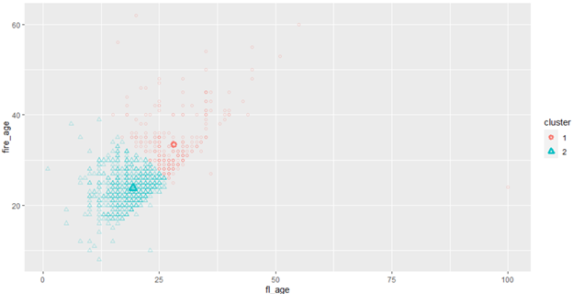
K-means clustering
Upon K-means clustering fl_age and fire_age-
Two neatly distinguishable clusters can be observed.
Scatter plot was used to observe the effect of parents_taught_money attribute on the observed clusters.

Slide 7
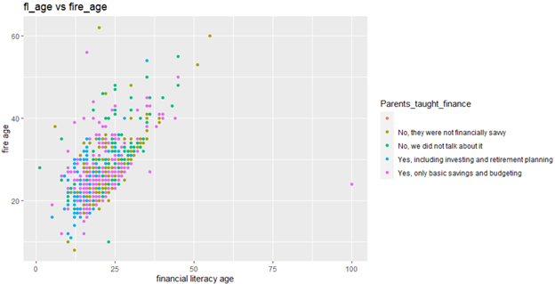
Scatter Plot
The plot displays the effect of parents taught money.
It influences the formation of two clusters before.
Pink and blue dots are grouped downwards which represents that individuals who were taught finances at home gained financial literacy earlier than those who were not.

Slide 8
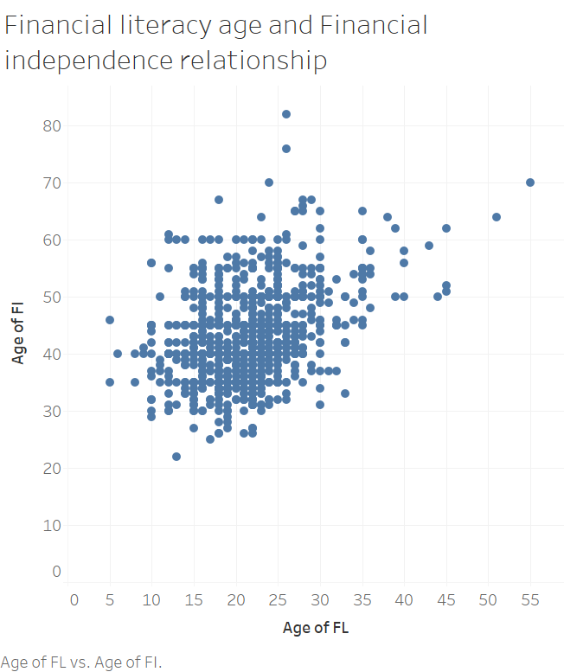

Slide 9
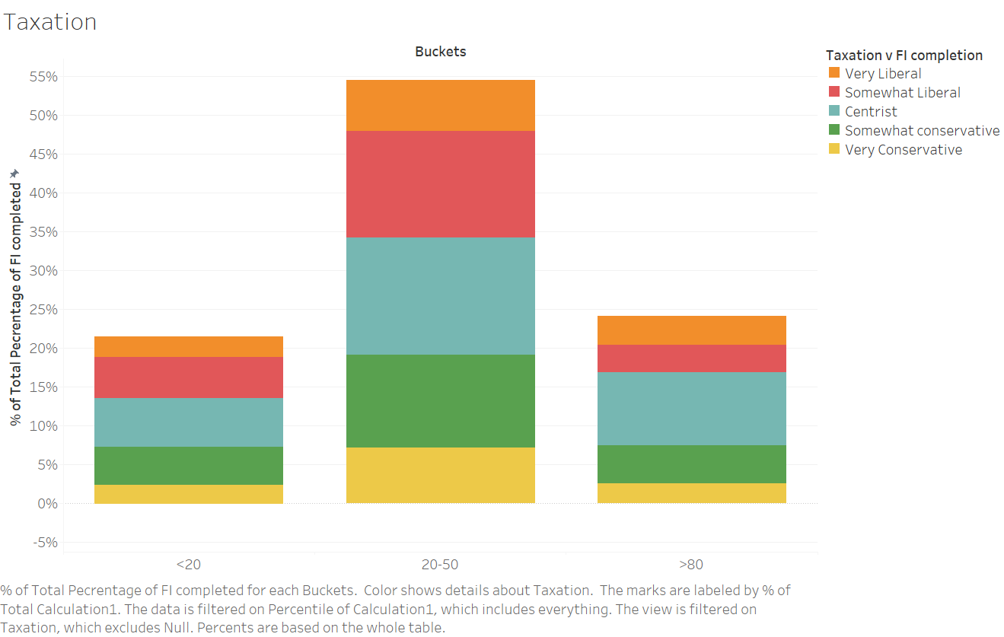

Slide 10
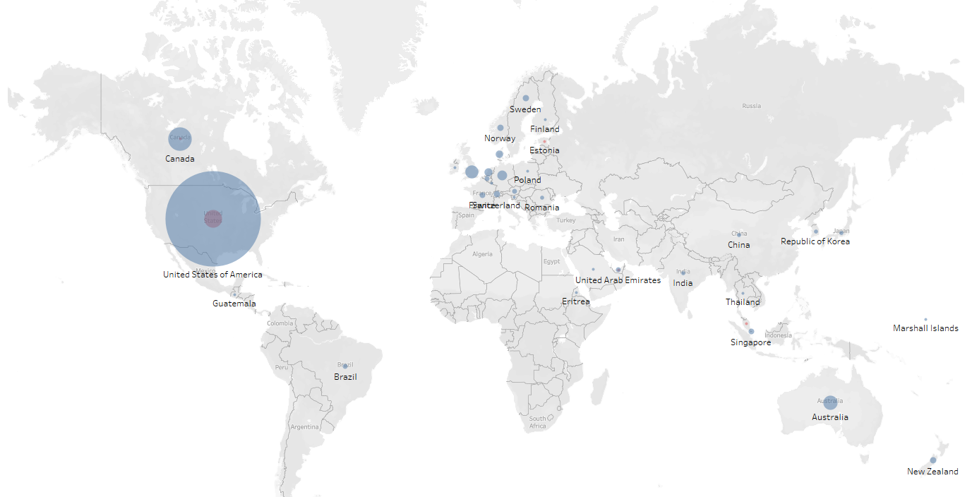
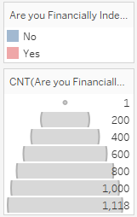
Financial Independence - Survey Distribution
1378 total survey participants

Slide 11
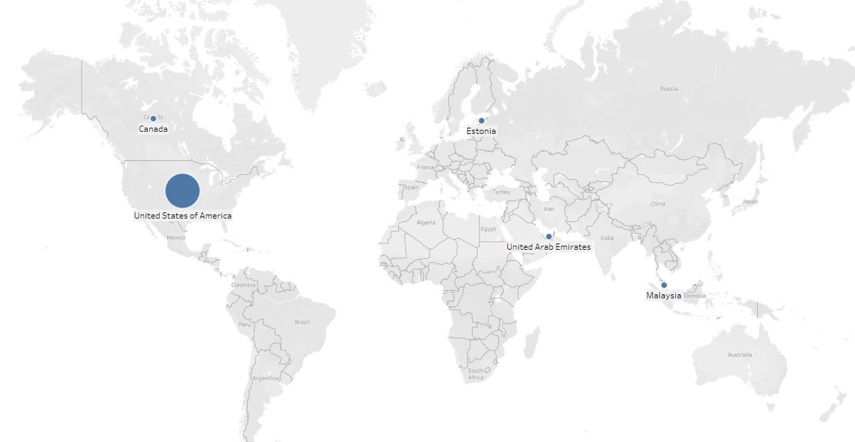
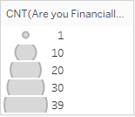
Financial Independence - Survey Distribution
46 are financially independent

Slide 12
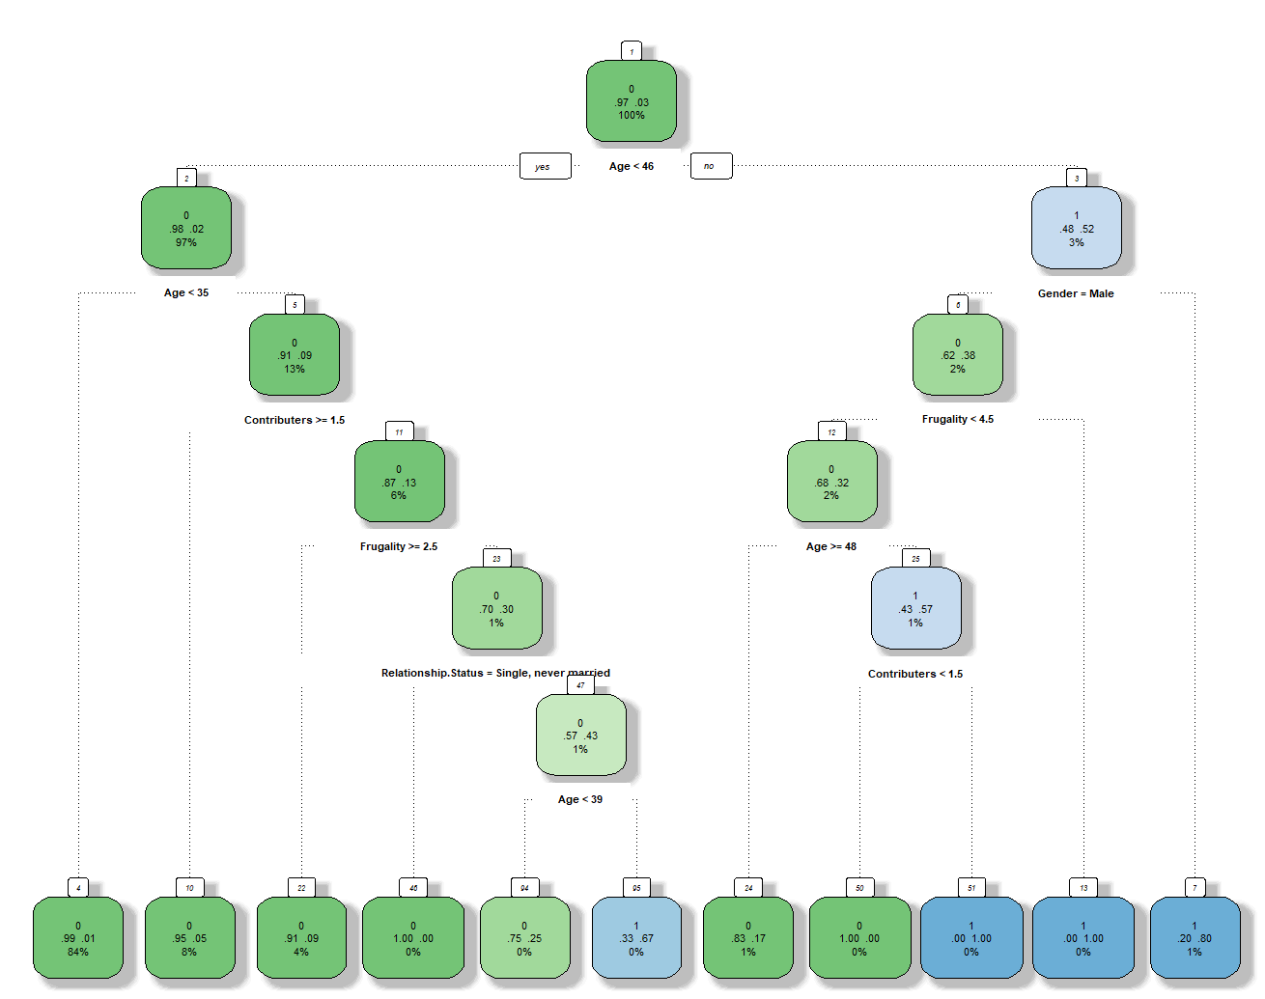
Decision Tree
Age is best predictor of financial independence; followed by gender
Women over the age of 46 were more likely to be financially independent

Slide 13
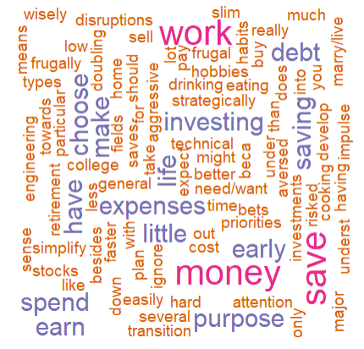
Word Cloud: Tips for Achieving Financial Independence
Those who have achieved financial independence offered some tips on how others can join them
This word cloud pulls out some of the commonly referenced words from the tips provided
Top 3 words:
Work
Money
Save

